Slide 1
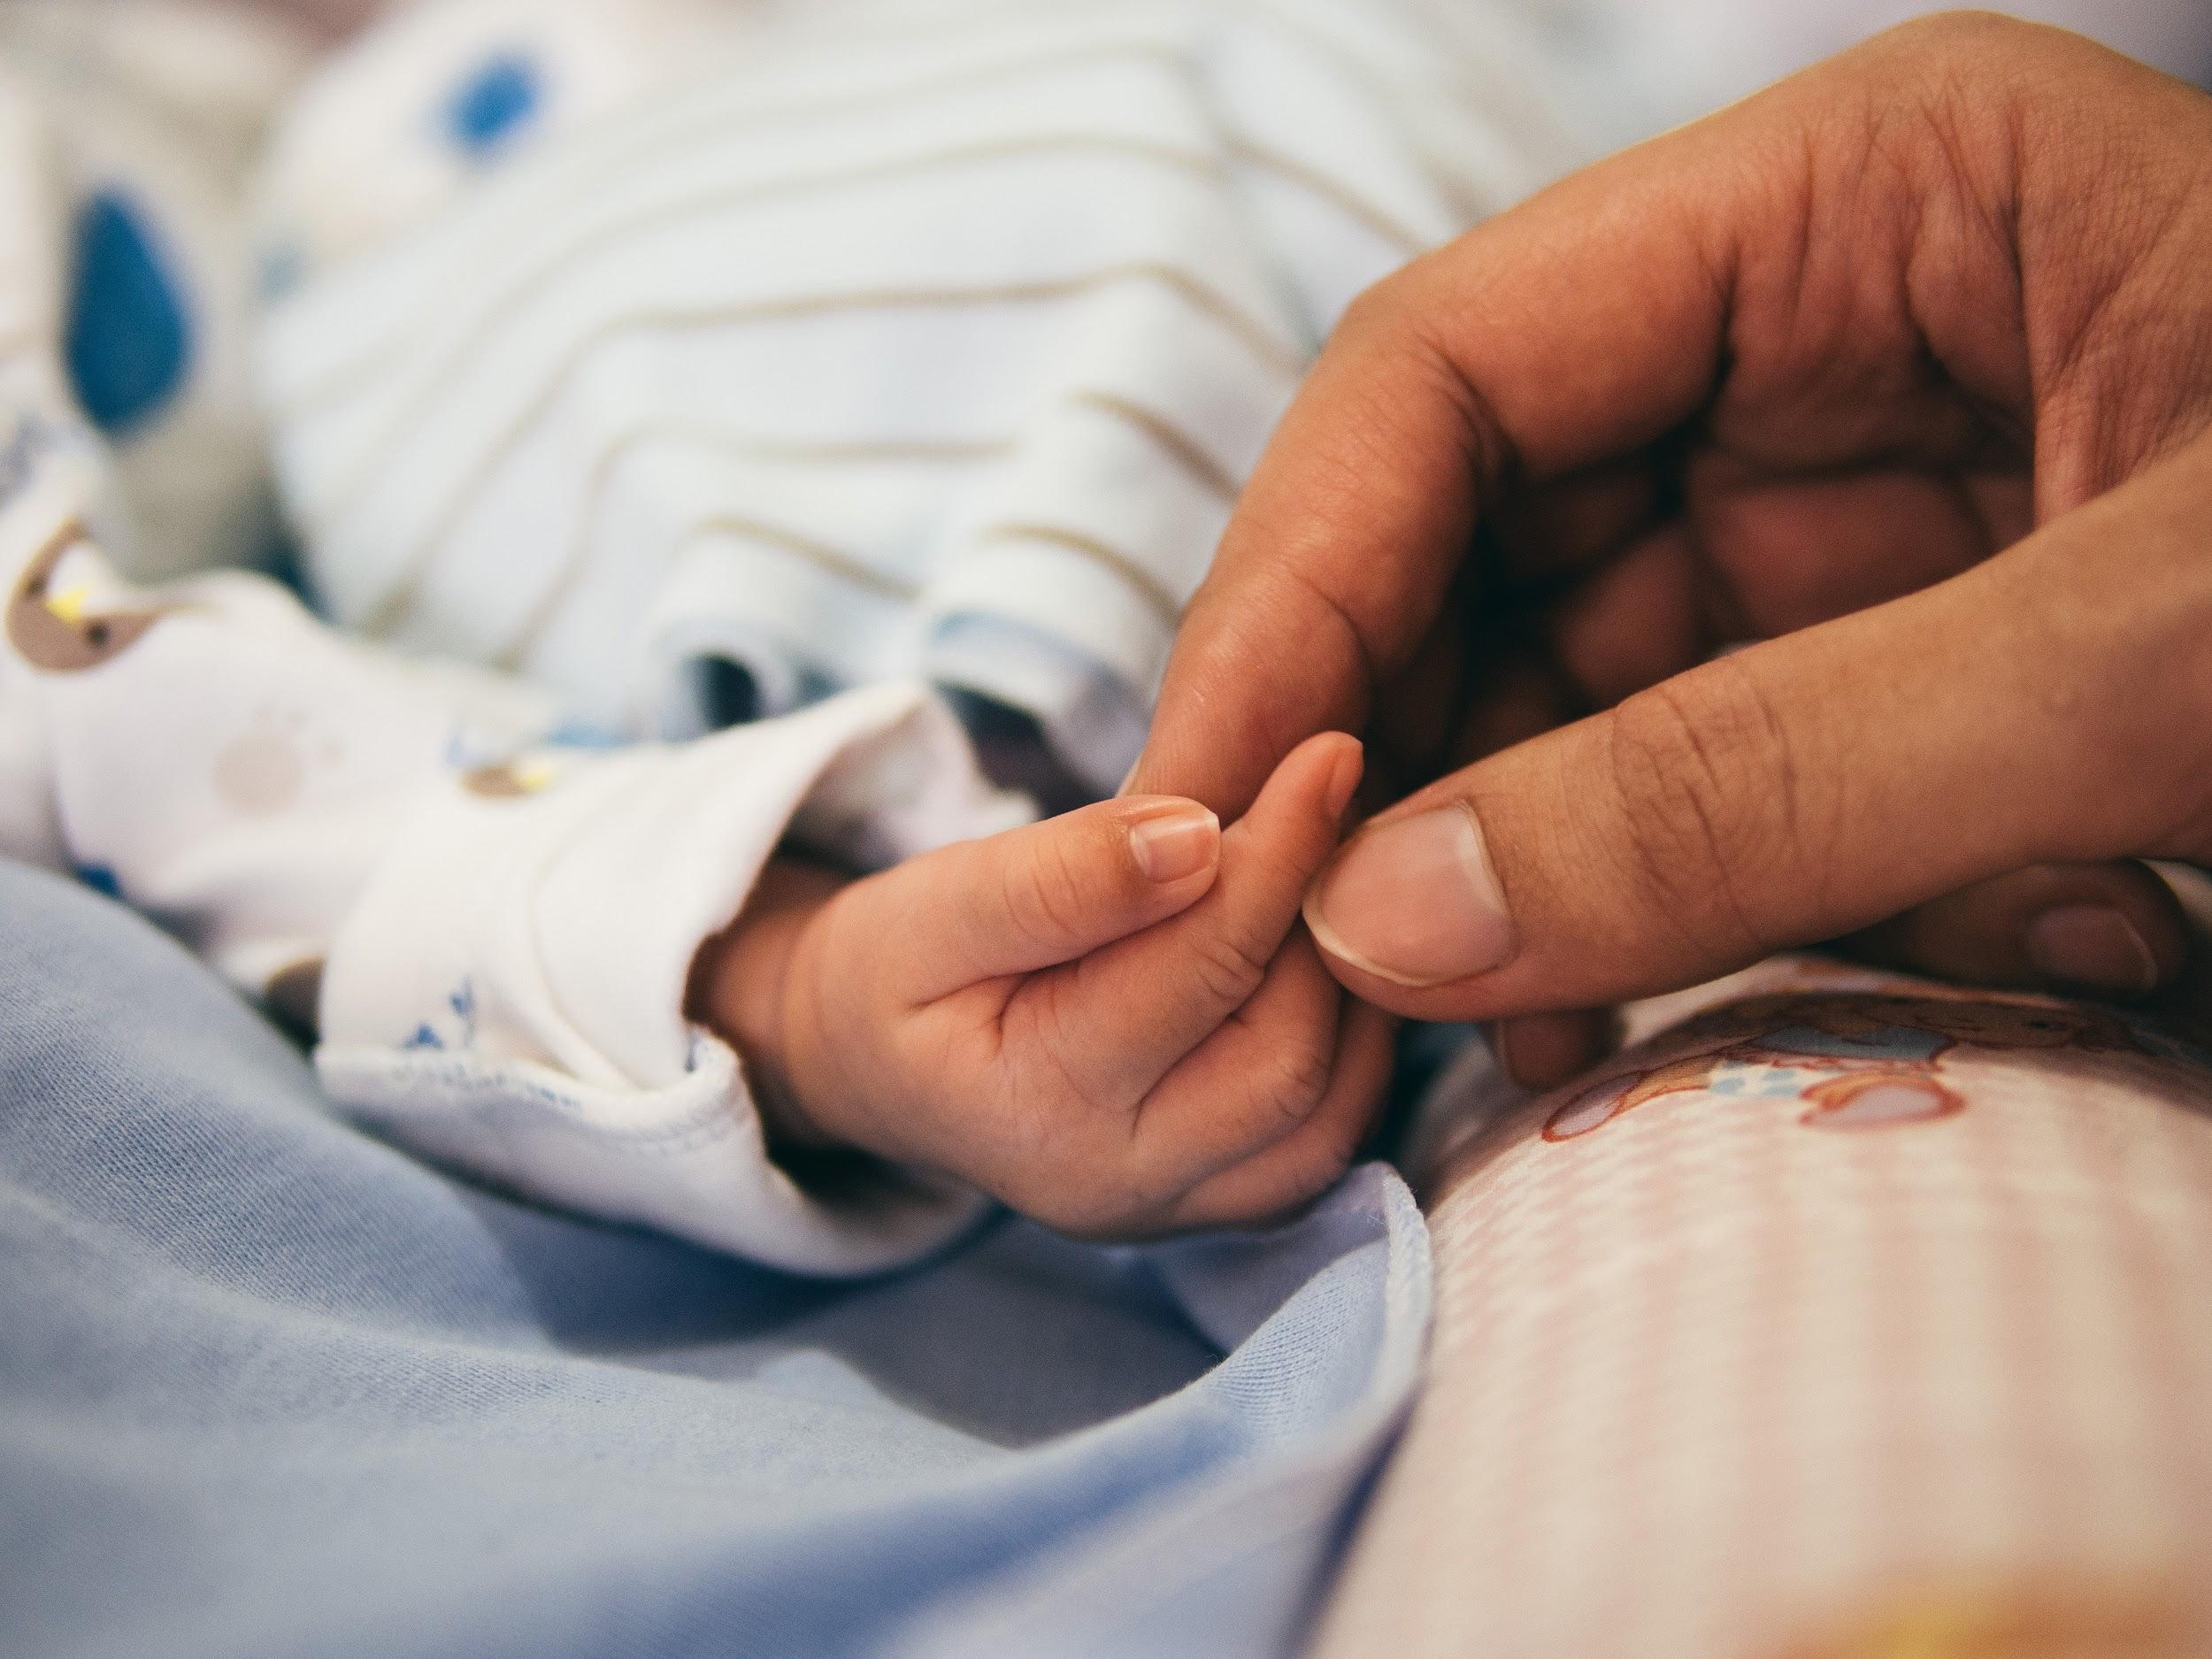
Contraceptive Method Choice
Data Science Group Assignment
Farhaad Khan, Muhammad Zain Adil, Waqas Haque, Osvaldo Mafuana

Slide 2
Overview
Goal: Predict the current contraceptive method choice of a woman based on her demographic and socio-economic characteristics
The samples are married women who were either not pregnant or do not know if they were at the time of interview.
This dataset is a subset of the 1987 National Indonesia Contraceptive Prevalence Survey

Slide 3
Data information
9 Attributes
Wife’s age
Wife’s education
Number of children ever born
Wife’s religion
Wife’s employment status
Husband’s occupation
Standard-of-living
Media exposure
1473 Records

Slide 4
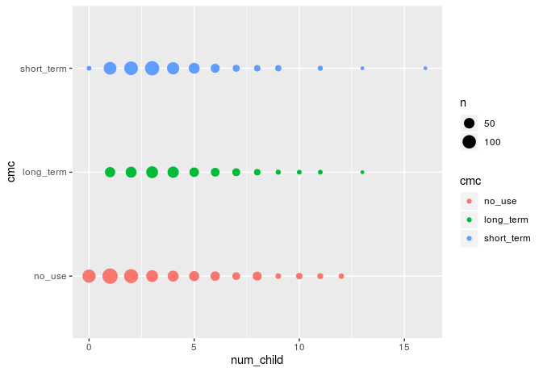
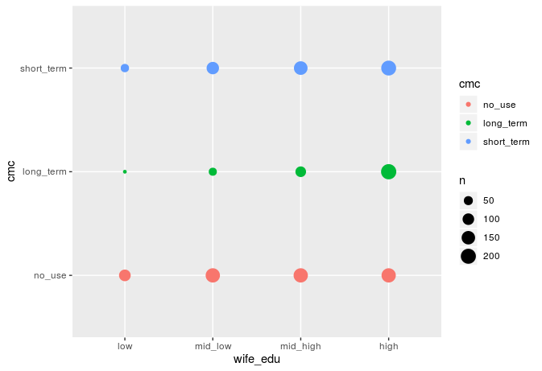
Number of Children and Wife Education Correlation

Slide 5
KNN-Simplified
In KNN, K is the number of nearest neighbors and the number of neighbors is the core deciding factor
The KNN algorithm assumes that similar things exist in close proximity. In other words, similar things are near to each other.
KNN algorithm is one of the simplest classification algorithm. Even with such simplicity, it can give highly competitive results

Slide 6
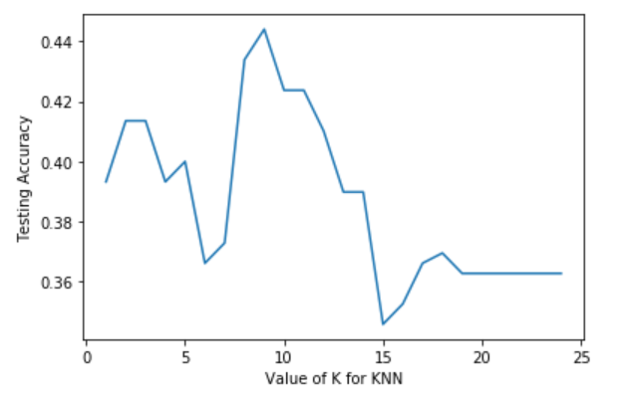
How do we chose the factor K?
To select the K that’s right for your data, we run the KNN algorithm several times with different values of K
Choose the K that reduces the number of errors we encounter while maintaining the algorithm’s ability to accurately make predictions

Slide 7
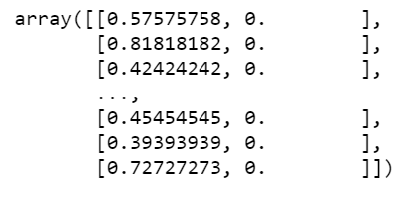
How did i improve my accuracy?
For better results, normalizing data on the same scale is highly recommended so that all of them can be uniformly evaluated
Adjusted the value of K to get the highest possible accuracy

Slide 8
Decision Tree
What is decision tree ?
Model of decisions and their possible consequences
It's a useful tool that cover both classification and regression.
Important attribute that hold a place in contraception category
Number of child
Wife age
Wife education
Number of child long term or short term

Slide 9

Accuracy using k-fold

Slide 10
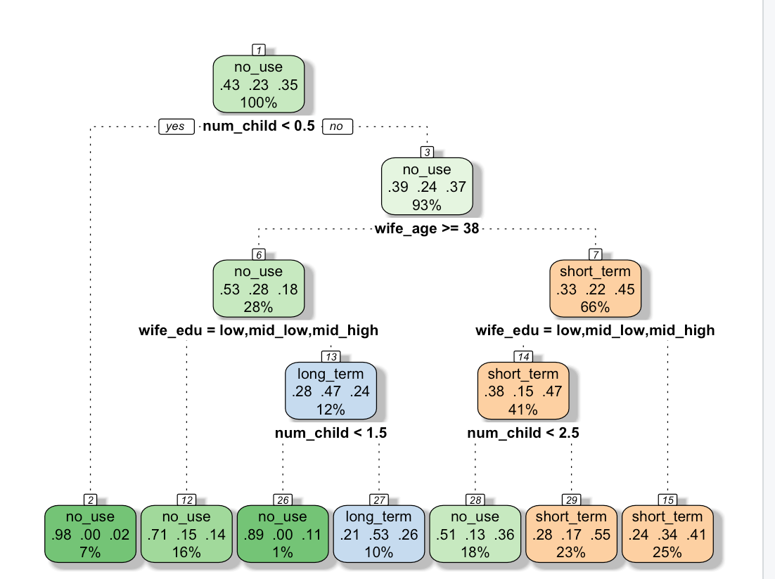

Slide 11
Accuracy for the cross validation

Slide 12
Neural Networks (procedure)
Added 3 new attributes representing each contraception category
Binary Sigmoid Function
Created 3 different models
Increased accuracy by adding nodes to hidden layer

Slide 13
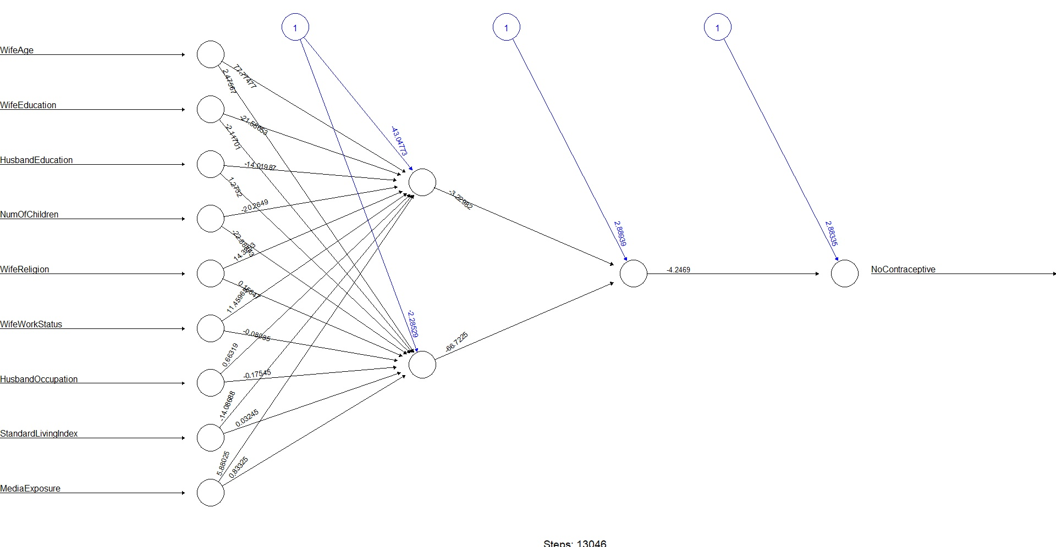

Slide 14
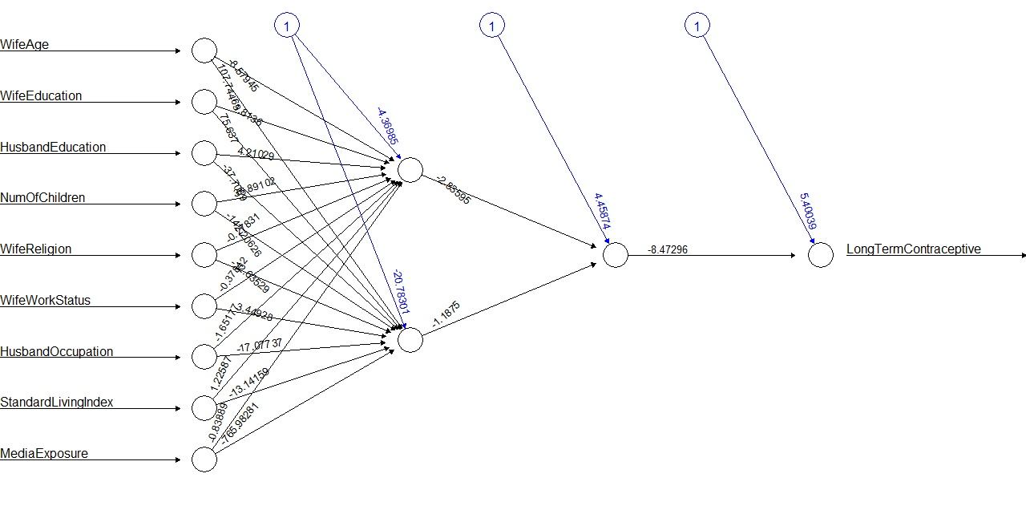

Slide 15
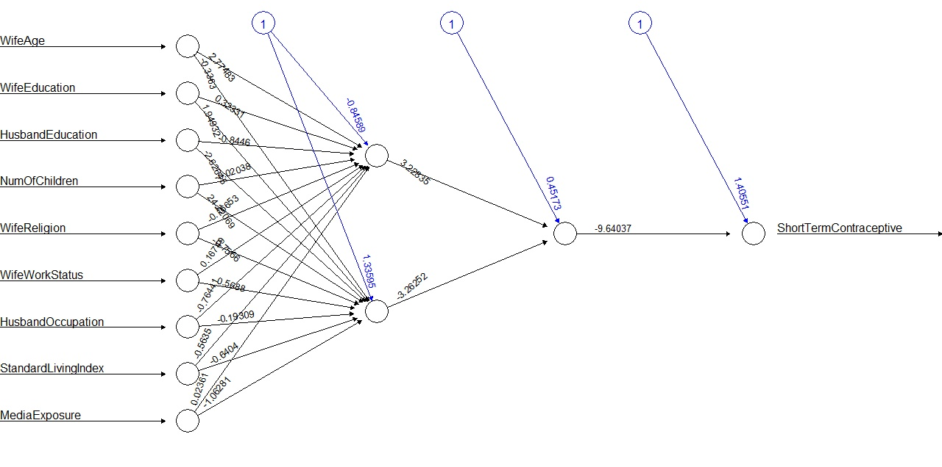

Slide 16
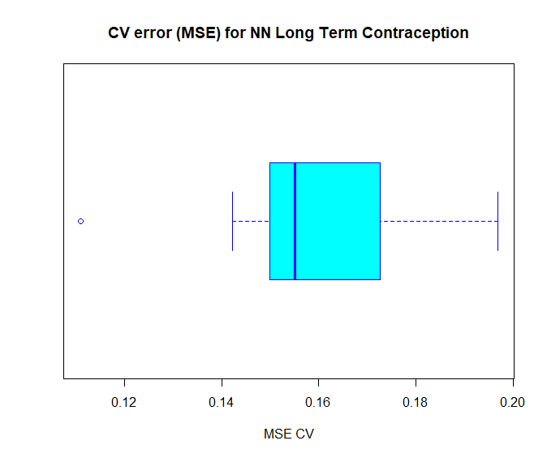
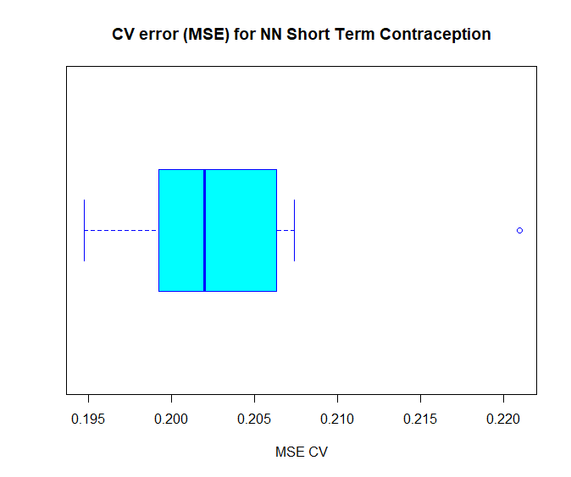
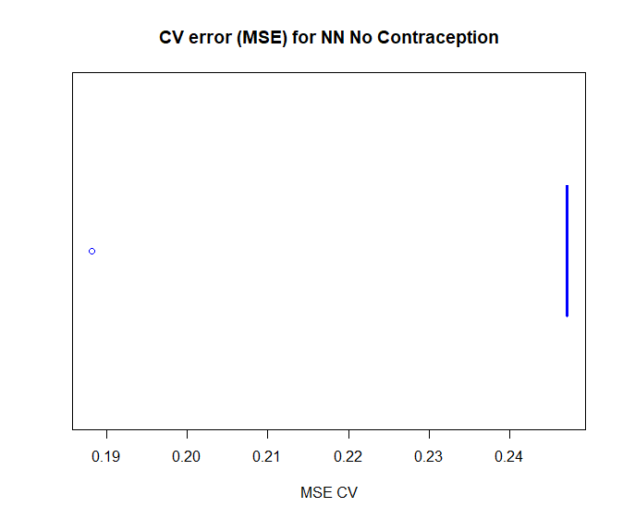
Neural network model 10-Fold Cross Validation

Slide 17
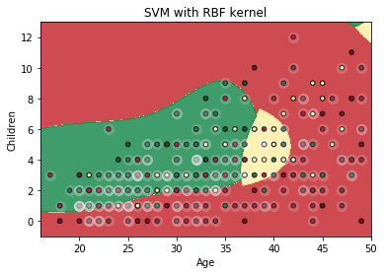
Support Vector Machine
SVM is a classifying method that separates two distincts variables with a hyperplane. In other words, given labeled training data (supervised learning), the algorithm outputs an optimal hyperplane which categorizes new examples.

Slide 18
SVM Procedure
Split into training and testing set.
Set up model.
Optimal parameters: C = 100, kernel = 'rbf' and gamma = .001
Find predictions.
Determine accuracy.

Slide 19
SVM using K-Fold Cross Validation
[0.56375839 0.57432432 0.52027027 0.54421769 0.59863946 0.55102041, 0.62585034 0.5170068 0.54421769 0.56849315]
Accuracy: 0.56 (+/- 0.06)

Slide 20
Conclusion/Findings
SVM Accuracy: 56%
Decision tree accuracy: 56%
KNN accuracy: 42%
NN accuracy: 98% accuracy

